Slide 1
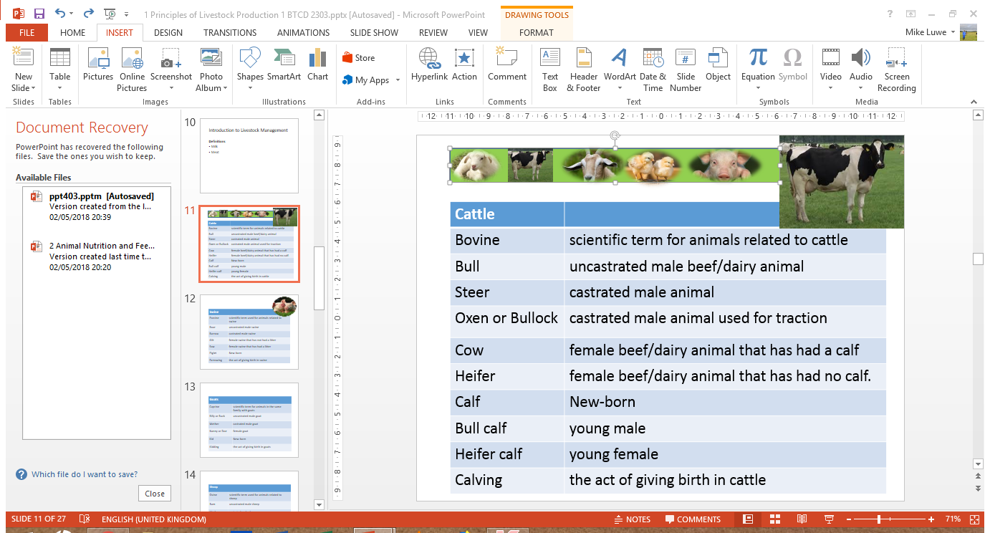
Layer Production and Management
Michael Luwe
Veterinarian
Department of Animal Health and Livestock Development

Slide 2
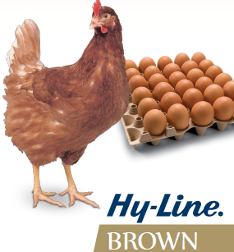
Layer Production and Management
Common Strain of Layers in Malawi
Hy-Line
Strains specifically developed for egg production after several crossings of different breeds.
Usually 100 – 1000 birds are raised under small-scale (backyard) farming.
Commercial farms can raise over 10,000 birds
Notes:
Shaver hybrid also used for commercial egg prodn elsewhere.

Slide 3
Chicks and Growers Management
Management of chicks is similar to that of broilers.
For growers, ensure the following:
Supplement with green feeds
Provide perches
Avoid giving birds left-over feed

Slide 4
Housing
Two housing systems used:
Deep litter system
Battery cage
Usage of artificial light can help to induce egg production.
In deep litter system, have:
Stocking density of 5 -6 birds per m² .
Nesting boxes (30 x 30 x 40cm) for every 4 to 5 birds and replace litter in the nesting boxes once a week.

Slide 5
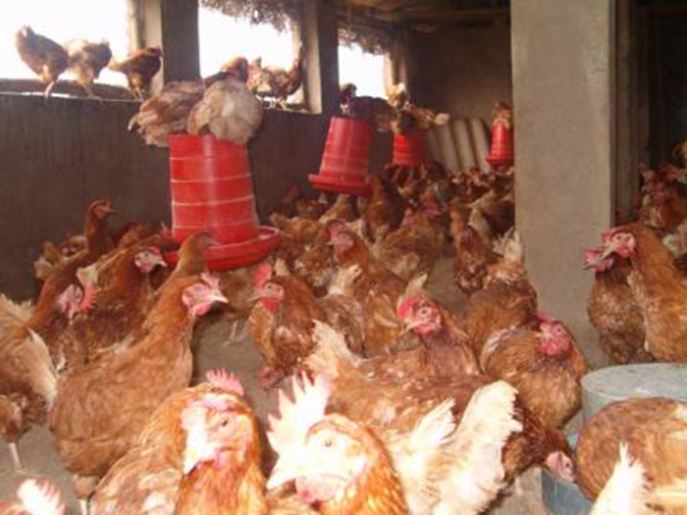
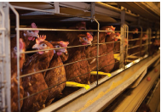
Housing systems
Deep litter
Battery Cage

Slide 6
Feeding Regimes and Water Supply
Feed supplied as follows:
Chick mash ~ day old to 6 weeks
Growers mash ~ 7 weeks to point of lay (17 weeks)
Layers mash ~ 18 weeks and over
Provide tubular feeder for every 15 – 20 birds and a drinker for every 30 birds.
Pre-lay feed can be introduce at 15weeks to enable the birds build up calcium deposits if available on the market.
Feed and fresh, clean water should be provided all the time.

Slide 7
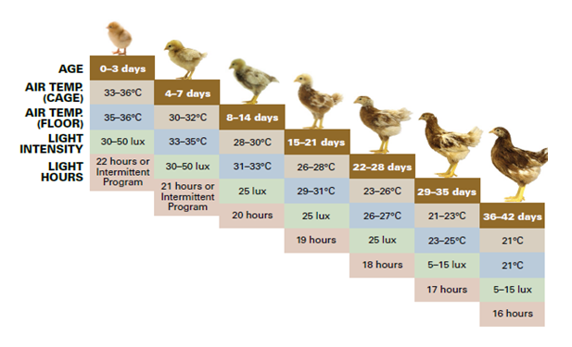
Temperature and Lighting
Source: Hy-Line Manual, 2016
Notes:
During brooding period, light hours may be gradually reduced from the first to about the 4th week. Reduction in daylight hours delays sexual maturity and the beginning of egg laying.
Consult your hatchery for the lighting program which is applicable to their strain.

Slide 8
Qualities of a Good Layer
Effective laying period is 52 weeks.
Egg production for a good hen is 280+ per year.
Usually at 21 weeks, 5% of the birds will be laying and peak production is reached at about 27 – 32 weeks of age (80-90%).

Slide 9
Differences btwn Laying & Non-Laying Hens
PART | LAYING HEN | NON-LAYING HEN
Pubic bones | Wide apart and thin (takes 3 to 4 fingers) | Blunt, rigid and close together (takes 2 or less fingers)
Vent | Large, smooth and moist | Small, shrunken and dry
Abdomen | Full, soft and pliable(easily bent, shaped, or influenced without breaking.) | Contracted, hard and freshy
Comb | Large, smooth, bright red, glossy and soft | Shrivelled, dry, dull and scaly
Ear lobes and wattles | Smooth and soft | Rough and dry

Slide 10
Aspect | Laying Hen | Non-Laying Hen
Egg production | Actively produces eggs | Does not produce eggs
Comb and wattles | Large, bright red, soft and warm | Small, pale, dry or shrunken
Vent (cloaca) | Large, moist, oval, and soft | Small, dry, round, and tight
Pelvic (pubic) bones | Wide apart (2–3 fingers can fit) | Close together (1 finger or less)
Abdomen | Soft, full, and flexible | Hard, tight, and firm
Body condition | Slightly thinner due to egg laying | Heavier or fatter
Behavior | Active, alert, eats more | Less active, eats less
Feeding requirement | High nutrient demand (especially calcium & protein) | Lower nutrient requirement
Feather condition | Often worn or dull due to laying stress | Feathers smooth and glossy
Purpose | Kept mainly for egg production | Kept for meat, breeding rest, or immature stage

Slide 11
Culling
Refers to the removal of sick, injured, or unproductive birds from the flock.
Reasons for culling:
Prevention of spread of diseases.
Increase in the quality of the stock.
More space is allowed for the remaining birds.
Increase in profits principally by reducing feed required to produce a dozen eggs.

Slide 12
Moulting
This is the process of shedding and renewing feathers.
Natural moulting can occur at any time due to birds being subjected to stress.
Stress factors include:
Decreased lighting
Diseases
Poor nutrition
Prolonged broodiness
Mismanagement e.g. poor ventilation, debeaking.
10 – 30% less egg production achieved after moulting

Slide 13
Feather pecking and Cannibalism
Feather pecking is where feathers are pulled from one hen by another hen, and it is caused by overcrowding and boredom.
Cannibalism (the act of an animal eating another animal) happens because of poor management and can be difficult to eliminate if it becomes a habit.
To help stop feather pecking and cannibalism, the birds should be kept occupied. This can be done by providing extra space for the hens to free range or hanging vegetable leaves for them to peck.
Debeaking also discourages birds from developing the habit of cannibalism.

Slide 14
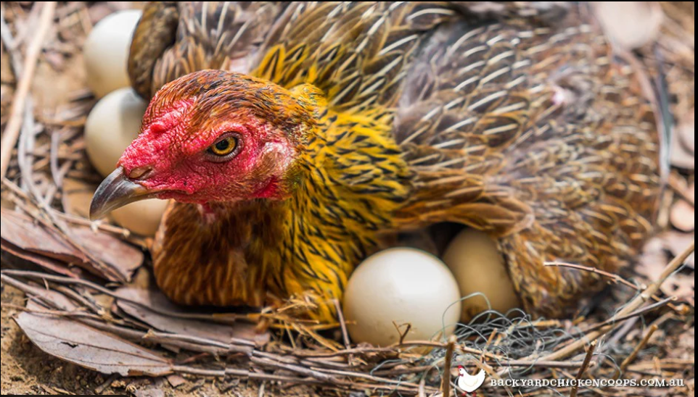
Broodiness
Broodiness is a natural behaviour in hens where they stop laying eggs and sit on eggs continuously to incubate and hatch them.
This is a natural maternal instinct of hens and is needed to incubate eggs, but it will also cause a reduction in production as the broody hen occupies a nest but does not produce eggs.
If hens are allowed to sit on their entire clutch of eggs then they are more likely to go off the lay so collect eggs frequently to prevent this.
Broody hens should be moved to a separate wire coop without a nest box and given feed and water.

Slide 15
Egg Eating
Hens will naturally eat any broken egg shells but sometimes this can develop into a vice where hens peck and eat unbroken eggs.
This is an issue as it can result in large losses of production, and reduce annual egg production of the flock.
Egg eating is not caused by a nutrient deficiency and it can be prevented by removing any broken shells regularly, placing decoy eggs in nests and collecting eggs regularly.

Slide 16
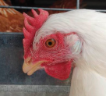
Beak Trimming or Debeaking
Trim beaks between 7 – 10 days of age to reduce feed wastage and make the beak less damaging to other birds.
If necessary, re-trim at 6 weeks or 12 – 14 weeks of age.
Do NOT beak-trim sick or stressed birds.
Trim one-third of the upper beak.
Provide vitamins at beak trimming time.

Slide 17
Egg Collection and Storage
Eggs should be collected 3 to 4 times daily.
Dirty eggs should be cleaned with a dry cloth or if too dirty, clean with a warm wet cloth and then dry before placing in trays.
Eggs should be stored in a cool dry place in trays with the tip at the bottom.
High temperatures cause eggs to lose their quality.
Good eggs can stay for 2 weeks without going bad.

Slide 18
Layers’ Health
Prevent introduction of viral and bacterial diseases into the flock by implementing biosecurity measures.
Layer’s like broilers also affected by coccidiosis hence ensure that the house is always dry.
Vaccinate your birds at the right time and ensure that they are dewormed.
Isolate and treat any sick bird.
Mites can irritate the birds leading to poor performance. Treat housing with the recommended insecticide.

Slide 19
Vaccinations and Other Medications
Period | Vaccine | Disease | Method
7 days | Bursine II | Gumboro | Water
14 days | Hitchner | Newcastle | Water, eye drop
21 days | Bursine II | Gumboro | Water
28 days | Lasota | Newcastle | Eye drop, water
5 weeks | Fowl Pox | Fowl Pox | Wing web
16 weeks | Lasota | Newcastle | Eye drop, water
19 weeks | Dewormer | Worms | Water
Every 3 months | Lasota | Newcastle | Eye drop, water

